Slide 1

Robot Cale Assembly - 01
Nicolas Miranda
Capstone Project - Industry 4.0
2025-2026

Slide 2
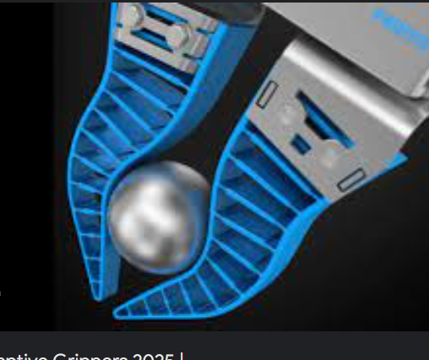
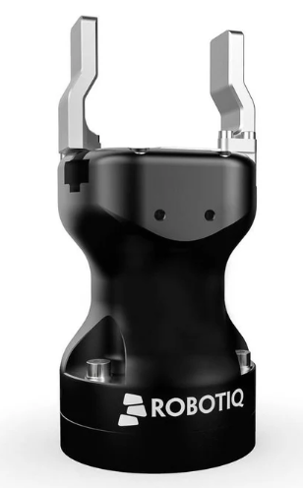
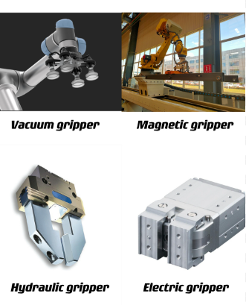
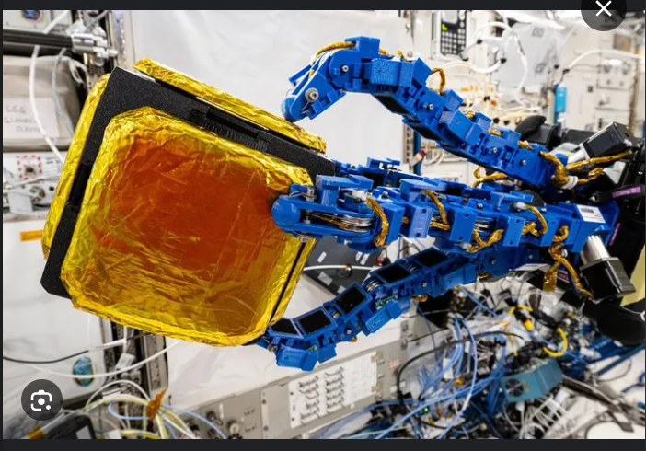
Grippers

Slide 3
Grippers

Slide 4
Grippers

Slide 5
Adaptative Grippers

Slide 6
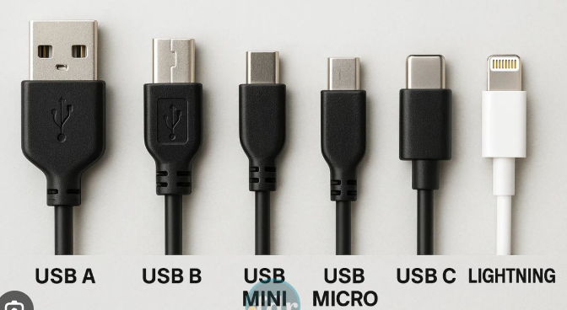
USB Types

Slide 7
Adaptative Grippers + USB

Slide 8
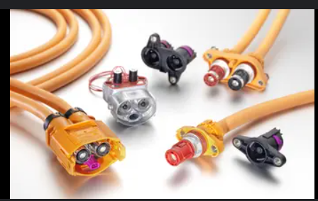
Adaptative Grippers + Plugs

Slide 9
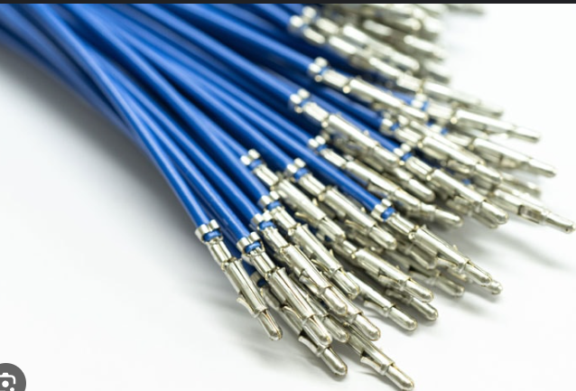
Grippers + Cable

